Slide 1

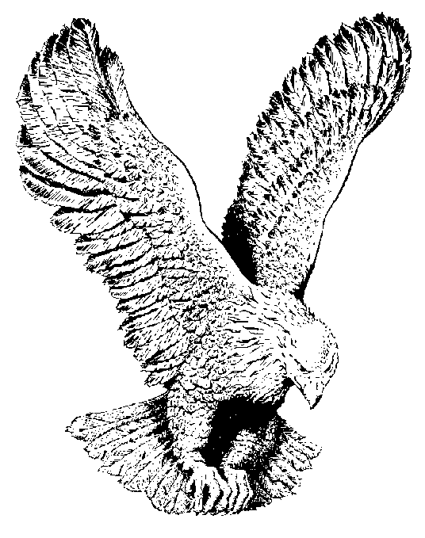
BURN ON
Burn on, burn on, Oh fire of God burn on,
Till all my dross is burned away,
Prepare me for the testing day
Oh, fire of God burn on.

